Slide 1
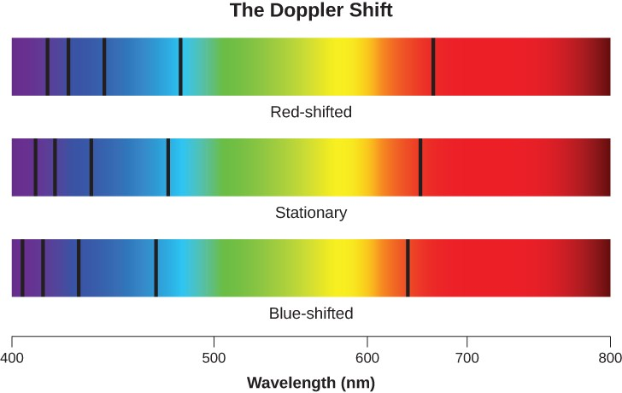
Exploring the Universe
Day 4
11/8 & 11/9

Slide 2
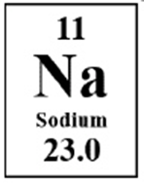
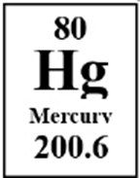
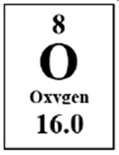
DQ
According the Big Bang model, none of the elements shown below could have existed during the early stages of the formation of the universe.
Sodium
Mercury
Oxygen
Identify the cause and effect connection that supports the previously given statement concerning these three elements.
A. Cause: Sodium atoms contain 11 protons and have an atomic mass of 23.0. Effect: Therefore, sodium atoms also have 11 electrons in their electron shells.
B. Cause: Hydrogen, the most simple of all elements, was the first atom formed. Effect: Gravity in stars formed all later atoms starting with hydrogen, then helium, etc.
C. Cause: Mercury is a metal with an atomic number of 80. Effect: It was too hot for metals to exist in the early universe. Only gases existed.
8ESS1.1

Slide 3
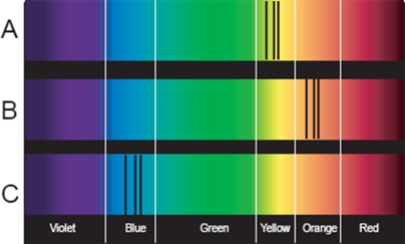
Spectral Line Analysis
We will discuss this in class.
Spectrums A, B and C are from identical stars within our galaxy. Spectrum A represents a possible spectrum of a star not moving toward or away from Earth. Spectrums B and C show stars in motion with respect to an observer on Earth. Compare the three spectrums and answer the following questions:
1. What is the approximate range in nanometers that the black lines fall in for A? for B? for C?
2. Which spectrum is that of a star moving toward Earth?
3. Which spectrum is that of a star moving away from Earth?
4. In comparison to A, which is moving faster, B or C? Using data, justify your answer.
A-Yellow, B – orange, C - Blue
Spectrum C
Spectrum B
C
8ESS1.1

Slide 4
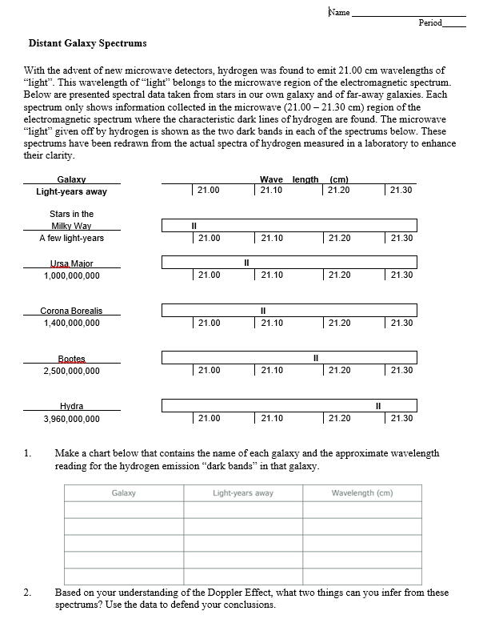
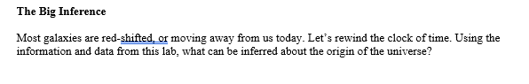
Distant Galaxy Spectrums
Go over this in class
8ESS1.1

Slide 5
Revise your final model
Peer review – Share your final model with your lab table group. Add any information they tell you is missing.
8ESS1.1

Slide 6
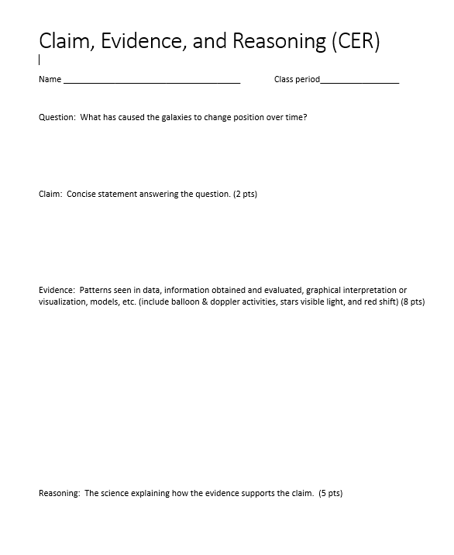
Claim, Evidence, and Reasoning
You may use your evidence collection table and your final model to answer the CER.
Include specific data from these papers for full credit.
Turn in the CER paper when you are finished.
8ESS1.1

Slide 7
1st period -VNC5W
2nd period – 6SFX3
3rd period – QB57N
4th period –JMU7Q
6th period – EMPW8
7th period - IK5DX
Big Bang Nearpod – Watch and take notes
8ESS1.1

